Slide 1
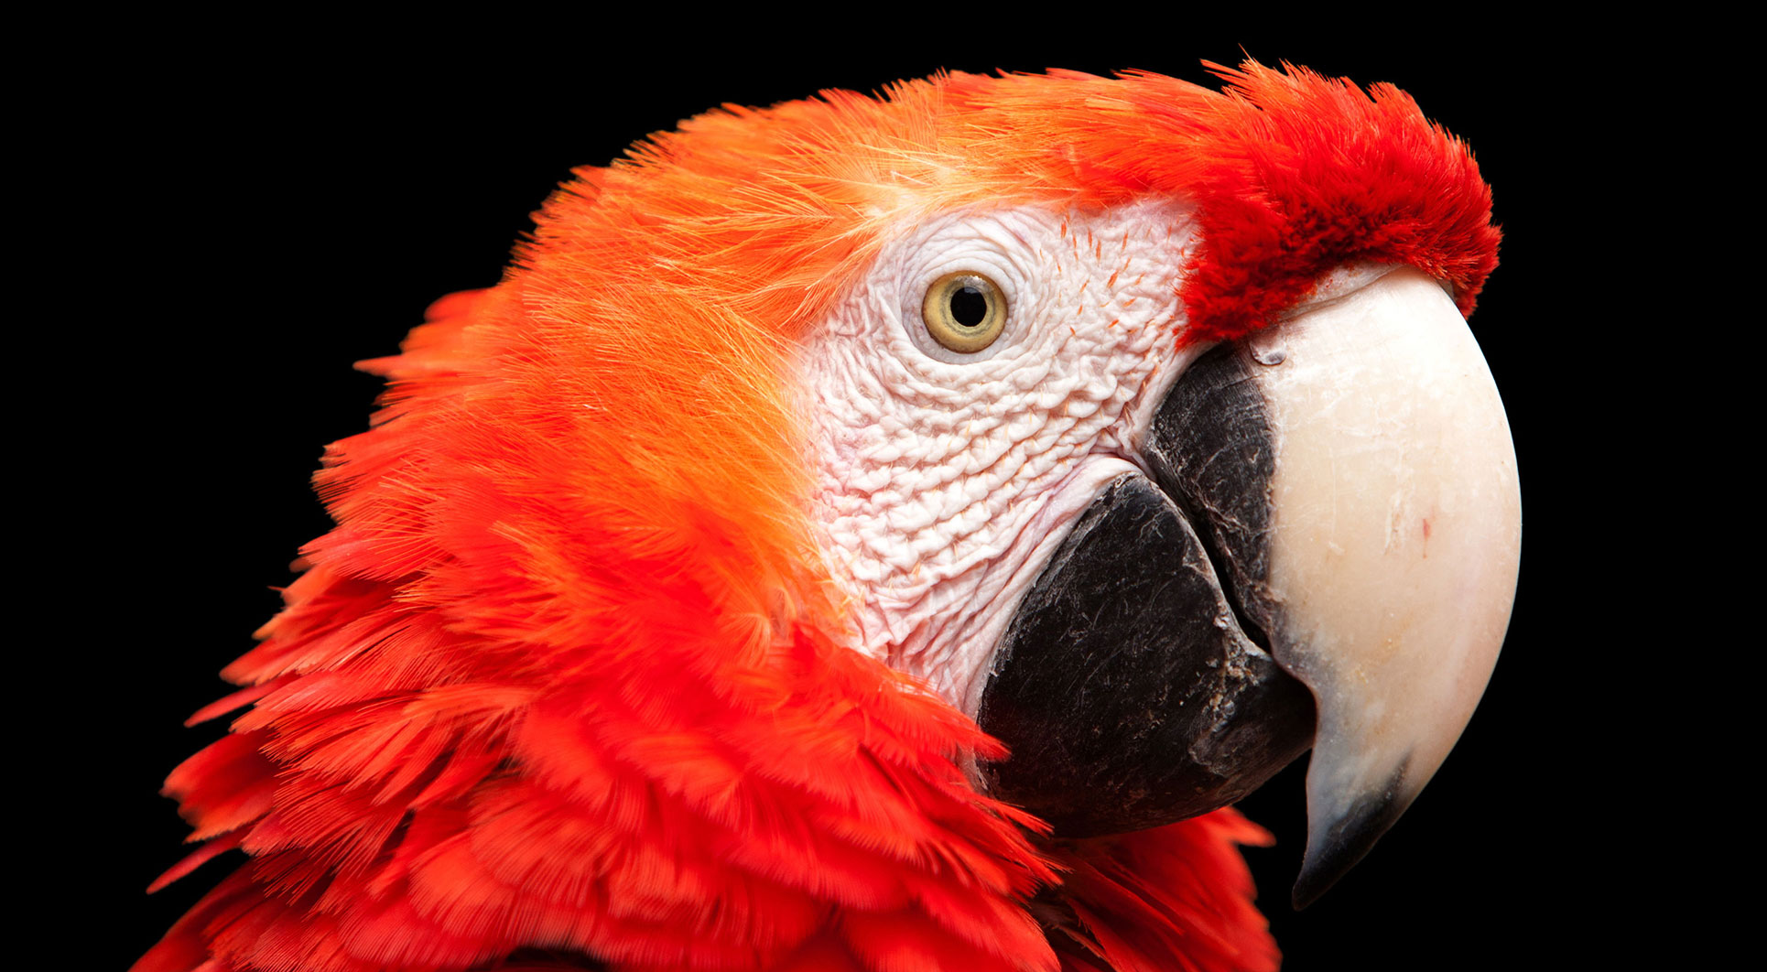
4.1 能塞进更多数据的魔盒 – 列表
《Python青少年趣味编程》
小牛叔出品

Slide 2
1、 内容
列表是特殊的容器变量，可以包含很多元素，类似于扑克牌的牌盒，它本身并不包括所有的扑克牌，计算机中列表可以包括一系列的数字、字符串或是其它任意对象的组合的。在Python之中使用中括号[]来表示一组列表，并且使用逗号分隔列表中的元素。
poke = ["2","3","4","5","6","7","8","9","10", "J","Q","K","A","Joker-","Joker+"]

Slide 3
2、 循环打印
poke = ["2","3","4","5","6","7","8","9","10", "J","Q","K","A","Joker-","Joker+"]
for p in poke:
print(p)

